Slide 1
WELCOME TO PRESENTATION
GROUP 7

Slide 2
Group Members there are :
Kim Hak
Sophart Phim
Bin Tim
Orn Sarath
Vun Theavy

Slide 3
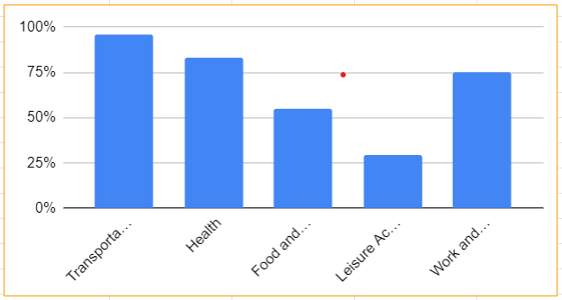
Topic: England
AGENDA:
Transportation
Health
Food and drink
Leisure Activities
Work and money

Slide 4
Transportation

Slide 5
Health

Slide 6
Food and drink

Slide 7
Leisure Activities

Slide 8
Work and money

Slide 9





Thank you !
www.passerellesnumeriques.org

